Slide 1
SWEG2071
Web Design and Programming
SWENG
AASTU
April 2018

Slide 2
Chapter 5
JavaScript

Slide 3
Outline
JavaScript Basics
Variables, Expression, Control, Array, Functions
Handling Events
User Inputs, Form Processing

Slide 4
Introduction
Is an object-based scripting language (lightweight programming language)
An interpreted language (means that scripts execute without preliminary compilation)
  A JavaScript is simply lines of executable code
Supported by all major browsers
JavaScript was designed to add interactivity to HTML pages
JavaScript is Case Sensitive
  Unlike HTML, JavaScript is case sensitive - therefore watch your capitalization closely when you write JavaScript statements, create or call variables, objects and functions.

Slide 5
Introduction(cont’d)
Are Java and JavaScript the same? NO!
Java and JavaScript are two completely different languages
  Javascript programs are interpreted in source code form.
  Java programs are first compiled into a device independent byte code format, which is then interpreted.
  Javascript is a small language and does not have many features that exist in Java
  Java is a powerful and much more complex programming language - in the same category as C and C++.
  Read more from Programming the World Wide Web

Slide 6
Object Orientation
JavaScript is NOT an object-oriented programming language
  Rather object-based
Does not support class-based inheritance
  Cannot support polymorphism
JavaScript objects are collections of properties, which are like the members of classes in Java
  Data and method properties
JavaScript has primitives for simple types

Slide 7
JavaScript Objects
Objects are collections of properties, which correspond to the members of classes in Java and C++.
  Data property: 2 categories -
    Primitives- non object types
    References to other objects
  Function or method property
All objects in a JavaScript program are indirectly accessed through variables
The root object in JavaScript is Object – all objects are derived from Object

Slide 8
Overview of JavaScript
Three parts:
Core: basics
  The heart of the language, including its operators, expressions, statements, & subprograms.
Client side:
  Collection of objects that support the control of a browser and interactions with users. E.g:
    With JavaScript, an HTML document can be made to be responsive to user inputs such as mouse clicks and keyboard use.
    Client-side JavaScript is an HTML-embedded scripting language
Server side:
  Server-side JavaScript is a collection of objects that make the language useful on a Web server—for example, to support communication with a database management system

Slide 9
What can a JavaScript do?
JavaScript gives HTML designers a programming tool - HTML authors are normally not programmers, but JavaScript is a scripting language with a very simple syntax! Almost anyone can put small "snippets" of code into their HTML pages
JavaScript can put dynamic text into an HTML page - A JavaScript statement like this: document.write("<h1>" + name + "</h1>") can write a variable text into an HTML page
JavaScript can react to events - A JavaScript can be set to execute when something happens, like when a page has finished loading or when a user clicks on an HTML element

Slide 10
What can a JavaScript do?(Cont’d)
JavaScript can read and write HTML elements - A JavaScript can read and change the content of an HTML element
JavaScript can be used to validate data - A JavaScript can be used to validate form data before it is submitted to a server. This saves the server from extra processing
JavaScript can be used to detect the visitor's browser - A JavaScript can be used to detect the visitor's browser, and - depending on the browser - load another page specifically designed for that browser
JavaScript can be used to create cookies - A JavaScript can be used to store and retrieve information on the visitor's computer

Slide 11
JavaScript Execution
JavaScript scripts are executed entirely by the browser
Once downloaded there is no exchange of information with the server
  NB JavaScript programs can issue HTTP requests and load other pages
JavaScript scripts do not require the Java VM to be loaded
Thus JavaScript scripts tend to be fast

Slide 12
Format
JavaScript ignores spaces, tabs, and newlines that appear between tokens in programs
Semicolon (;) at the end of a statement is optional if each statement is on a separate line
  If more than one statement per line, separate them using (;)
Semicolons can be a problem
  They are “somewhat” optional
  Problem: JavaScript interprets line breaks as semicolons when it cannot parse the second line as a continuation of the statement on the first line.
Comments
  // single line comment
  /* multi line
  comment */

Slide 13
How to add JavaScript to an HTML page
  use the <script> tag
    in the <head> element
    <head>
    …
    <script type=“text/javascript”>
    … javascript code (functions)
    </script>
    or
    <script type=“text/javascript” src=“js_file.js”></script>
    </head>

Slide 14
How to add JavaScript to an HTML page(cont’d)
Anywhere in the HTML document
    …
    <body>
    …
    <script type=“text/javascript”>
    document.write(“hello”);
    </script>
    …
    </body>
    …

Slide 15
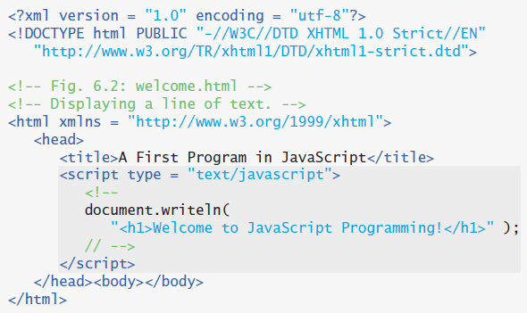
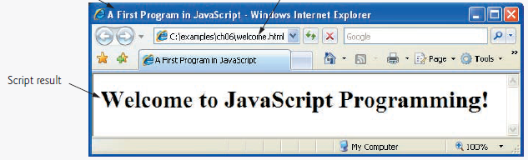
Example: Displaying a Line of Text

Slide 16
JavaScript in <head>
The example below calls a function when a button is clicked:
Example
<html>
  <head>
  <script type="text/javascript">
  function displayDate(){
  document.getElementById("demo").innerHTML=Date();
  }
  </script>
  </head>

Slide 17
Cont’d
<body>
  <h1>My First Web Page</h1>
  <p id="demo">Element to be updated…</p>
  <button type="button" onclick="displayDate()">Display Date</button>
  </body>
  </html>

Slide 18
Cont’d
You can place an unlimited number of scripts in your document, and you can have scripts in both the body and the head section at the same time.
It is a common practice to put all functions in the head section, or at the bottom of the page. This way they are all in one place and do not interfere with page content.

Slide 19
Using an External JavaScript
JavaScript can also be placed in external files.
External JavaScript files often contains code to be used on several different web pages.
External JavaScript files have the file extension .js.
Note: External script cannot contain the <script></script> tags!
To use an external script, point to the .js file in the "src" attribute of the <script> tag:

Slide 20
Cont’d
Example
<html>
<head>
<script type="text/javascript" src="xxx.js"></script>
</head>
<body>
</body>
</html>

Slide 21
Literals (constants)
12// The number twelve
1.2 // The number one point two
"hello world" // A string of text
“Hi” // Another string
true // A Boolean value
false // The other Boolean value
null // Absence of an object

Slide 22
Identifiers
  The first character must be a letter, an underscore (_), or a dollar sign ($). Subsequent characters can be a letter, a digit, an underscore, or a dollar sign.
  Examples
    i
    distance_value
    v13 _dummy
    $str
    _some_variable

Slide 23
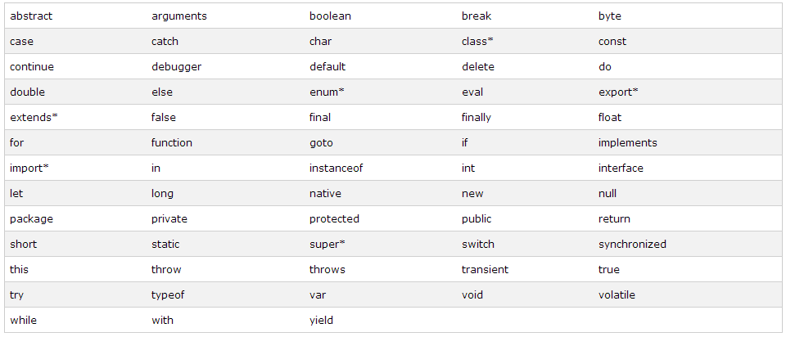
Reserved words

Slide 24
Datatypes and Variables
Datatypes
  numbers : integer, floating point, hexadecimal, octal
  strings
  boolean
  objects
  arrays
Variable Declaration
  syntax:
  var identifier [ = initial_value ]
    e.g. var x;
    var first_name = “Tola”;

Slide 25
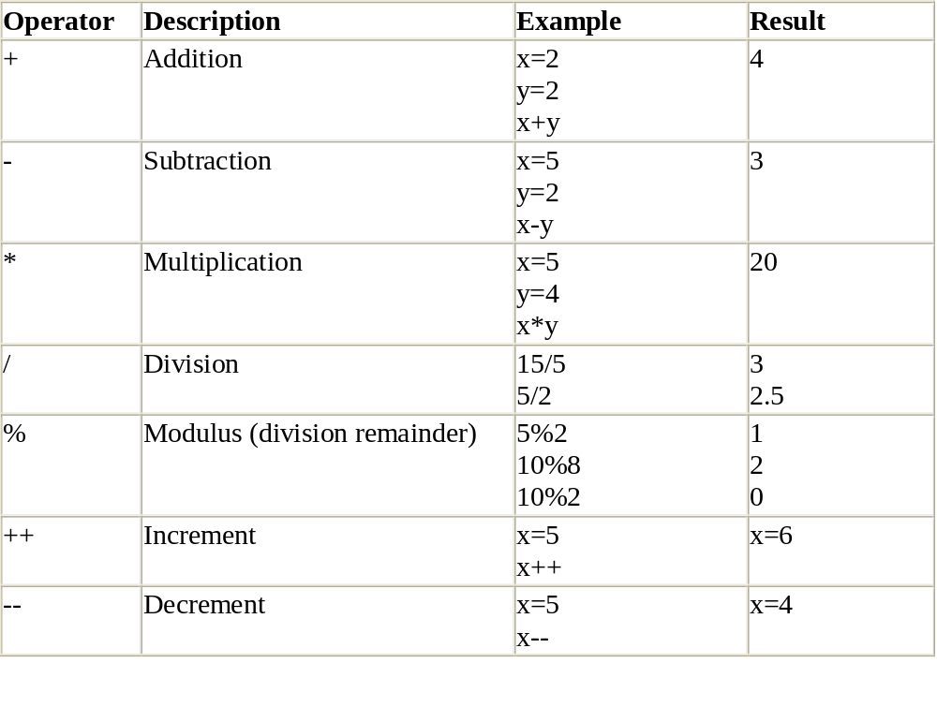
Operators
Arithmetic Operators

Slide 26
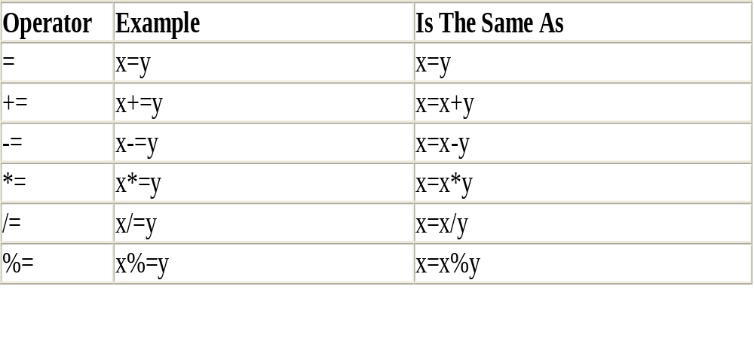
Operators (cont’d)
Assignment Operators

Slide 27
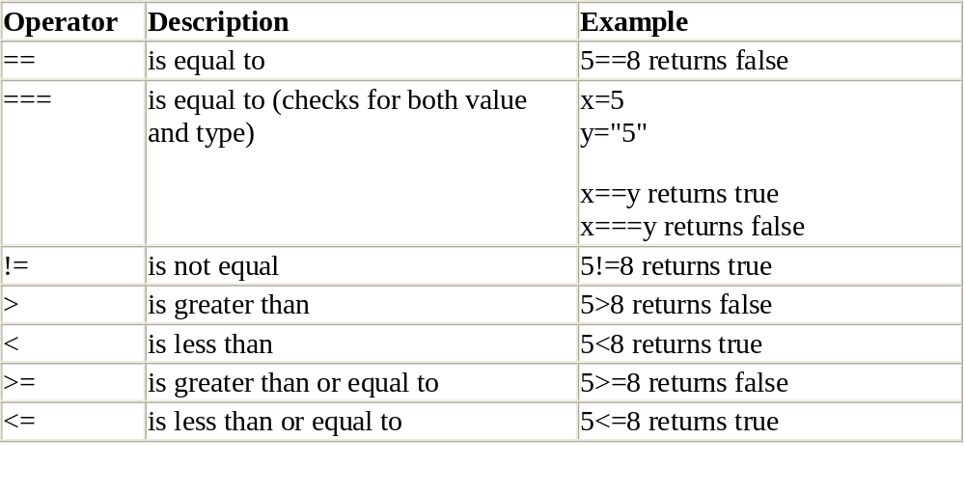
Operators (cont’d)
Comparison Operators

Slide 28
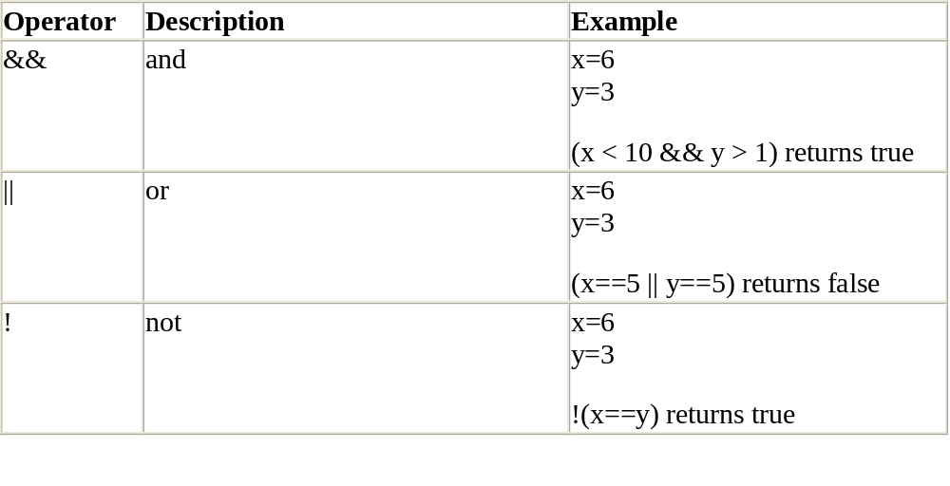
Operators (cont’d)
Logical Operators

Slide 29
Control Statements
Conditional statements
  if, if else
  switch
looping
  while
  do … while
  for
conditional operator
  var_name = (condition) ? true_value : false_value

Slide 30
Cont’d
<html>
<body>
<script type="text/javascript">
var i=0;
for (i=0;i<=10;i++)
{
document.write("The number is " + i);
document.write("<br />");
}
</script>
</body>
</html>

Slide 31
Cont’d
Break in a loop
Continue in a loop
JavaScript for…in Statement
The for...in statement loops through the properties of an object.
Syntax:
for(varaible in object)
{
code to be executed
}
Note: The code in the body of the for...in loop is executed once for each property

Slide 32
Cont’d
Example:
var person={fname:"John",lname:"Doe",age:25};
for (x in person)
{
document.write(person[x] + " ");
}

Slide 33
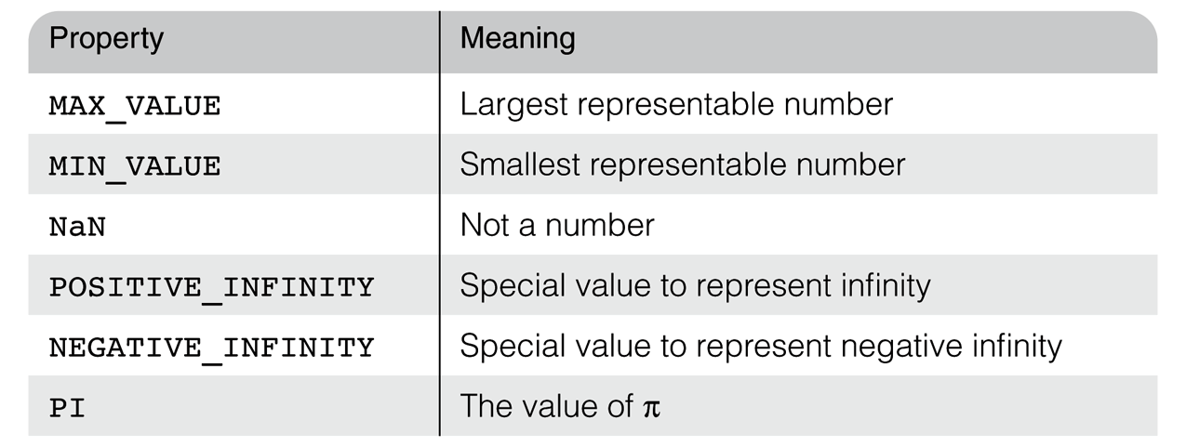

Math and Number Objects
The Math object provides a collection of properties of Number objects and methods that operate on Number objects
E.g. floor, round, max, min, trig functions, etc.
  e.g., Math.cos(x)
The Number Object has some useful properties:
Number.MIN_VALUE //displays 1.7976931348623157e+308
, results in an error (e.g., division by zero)

Slide 34
Math and…
The Number object has a method, toString
It converts the number through which it is called to a string.
var price = 427,
str_price;
...
str_price = price.toString();

Slide 35
String Properties and Methods
Because JavaScript coerces primitive string values to and from String objects when necessary, the differences between the String object and the String type have little effect on scripts.
String methods can always be used through String primitive values, as if the values were objects.
The number of characters in a string is stored in the length property
  var str = “George”;
  var len = str.length;
str is a primitive variable, but we treated it as if it were an
object (referencing one of its properties)

Slide 36
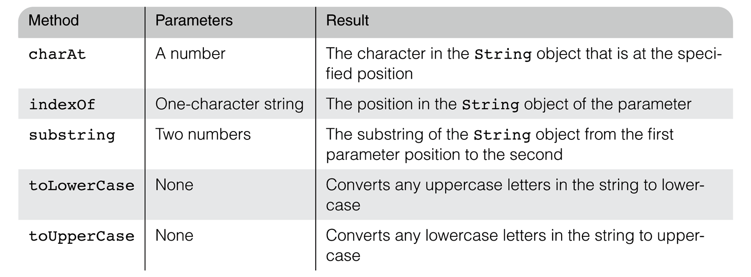
String Properties and Methods
Common methods:

Slide 37
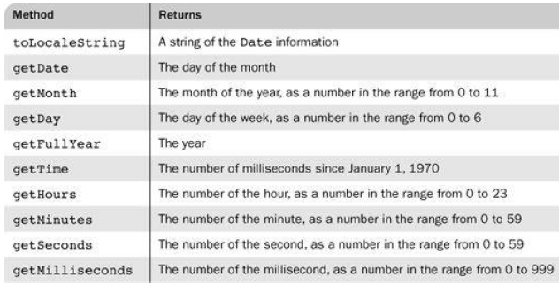
Date Object
Gives information about the current date and time
Create one with the Date constructor (no params)
  var today = new Date();
Local time methods of Date:

Slide 38
Functions
A function will be executed by an event or by a call to the function
  syntax:
  function function_name( argument1, argument2, …){
  statements
  [return value]
  }
  calling:
  [var_name = ] function_name(arg_list)
Internet Programming

Slide 39
Cont’d
<html>
<head>
<script type="text/javascript">
function displaymessage()
{
alert("Hello World!");
}
</script>
</head>
<body>
<form>
<input type="button" value="Click me!" onclick="displaymessage()" />
</form>
</body>
</html>
Internet Programming

Slide 40
Cont’d
The return Statement
The return statement is used to specify the value that is returned from the function
<html>
<head>
<script type="text/javascript">
function product(a,b)
{
return a*b;
}
</script>
</head>
<body>
<script type="text/javascript">
document.write(product(5,3));
</script>
</body>
</html>
Internet Programming

Slide 41
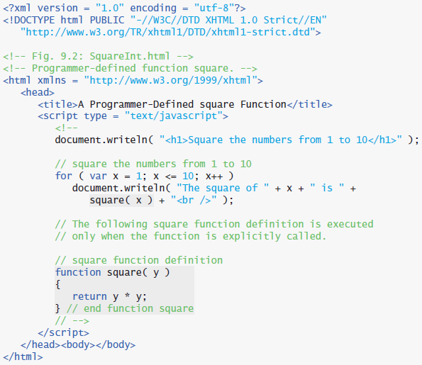
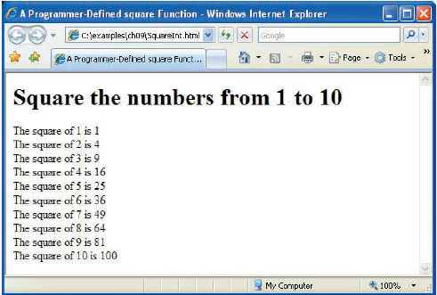
Example:

Slide 42
JavaScript Objects
“Everything” in JavaScript is an Object: a String, a Number, an Array, a Function....
In addition, JavaScript allows you to define your own objects.
JavaScript has several built-in objects, like String, Date, Array, and more.
An object is just a special kind of data, with properties and methods.
Accessing Object Properties
Properties are the values associated with an object.
The syntax for accessing the property of an object is:
objectName.propertyName
This example uses the length property of the String object to find the length of a string:
var message="Hello World!";
var x=message.length;
Internet Programming

Slide 43
Cont’d
Accessing Objects Methods
Methods are the actions that can be performed on objects.
You can call a method with the following syntax:
objectName.methodName()
This example uses the toUpperCase() method of the String object, to convert a text to uppercase:
var message="Hello world!";
var x=message.toUpperCase();
Internet Programming

Slide 44
JavaScript Array Object
An array is a special variable, which can hold more than one value at a time.
Create an Array
An array can be created in three ways.
The following code creates an Array object called myCars:
1: Regular:
var myCars=new Array();
myCars[0]="Saab";
myCars[1]="Volvo";
myCars[2]="BMW";
2: Condensed:
var myCars=new Array("Saab","Volvo","BMW");
3: Literal:
var myCars=["Saab","Volvo","BMW"];
Internet Programming

Slide 45
Cont’d
Access an Array
You refer to an element in an array by referring to the index number.
This statement access the value of the first element in myCars:
var name=myCars[0];
This statement modifies the first element in myCars:
myCars[0]="Opel";
Internet Programming

Slide 46
Cont’d
You Can Have Different Objects in One Array
All JavaScript variables are objects. Array elements are objects. Functions are objects.
Because of this, you can have variables of different types in the same Array.
You can have objects in an Array. You can have functions in an Array. You can have arrays in an Array
myArray[0]=Date.now;
myArray[1]=myFunction;
myArray[2]=myCars;
Internet Programming

Slide 47
Cont’d
Array Methods and Properties
The Array object has predefined properties and methods:
var x=myCars.length // the number of elements in myCars
var y=myCars.indexOf("Volvo") // the index position of "Volvo“
E.g.
<body>
<script type="text/javascript">
var x=new Array(2,4,6,8,10,12,14,16);
var y=x.length;
var z=x.indexOf(16);
document.write("length of x is: " + y + "<br /> Index of 16 is: " + z);
</script>
</body>
Internet Programming

Slide 48

Screen Output
JavaScript models the HTML document with the Document object
The model for the browser display window is the Window object
  The Window object has two properties, document and window, which refer to the Document and Window objects, respectively
The Document object has a method, write, which dynamically creates content
  The parameter is a string, often concatenated from parts, some of which are variables
document.write(“The result is: “, result, "<br/>");
  The parameter is sent to the browser, so it can be anything that can appear in an HTML document (any HTML tags)
If value of variable result is 42,

Slide 49

Note!
The write() method writes HTML expressions or JavaScript code directly to a document
Syntax:
The write() method is mostly used for testing
If it is used after an HTML document is fully loaded, it will delete all existing HTML

Slide 50
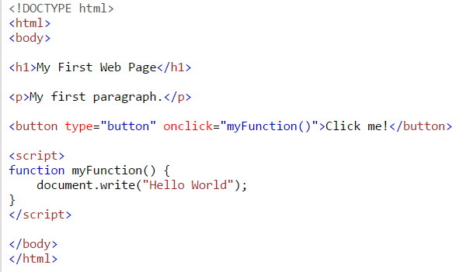
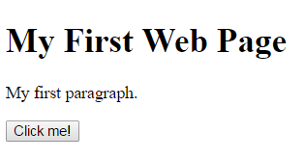


Slide 51
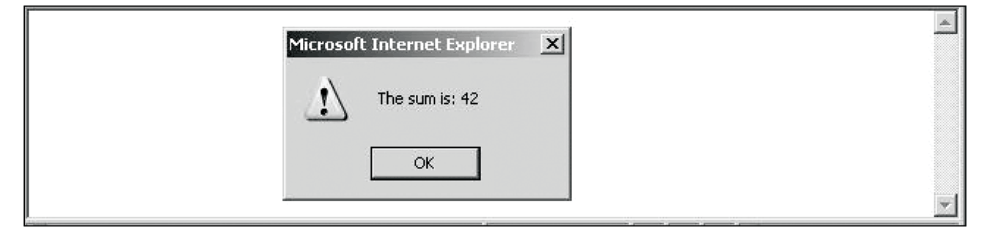
Screen Output
The Window object has three methods for creating dialog boxes
Alert
alert(“The sum is:” + sum + ”\n");
  Parameter is plain text, not HTML
  Opens a dialog box which displays the parameter string and an OK button
    It waits for the user to press the OK button
window is default object in JavaScript

Slide 52
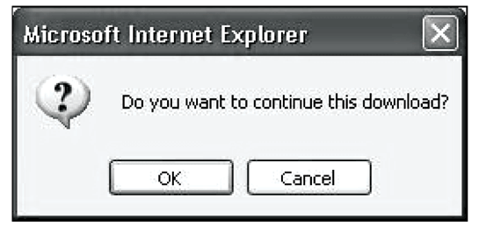
Screen Output
Confirm
var question = confirm("Do you want to continue this download?");
  Opens a dialog box and displays the parameter and two buttons, OK and Cancel
  Returns a Boolean value, depending on which button was pressed (it waits for one)

Slide 53
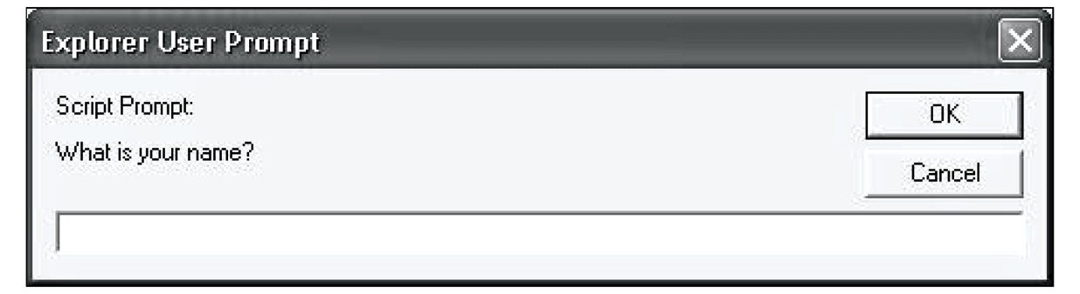
Screen Output
Prompt
prompt("What is your name?", “ ");
  Opens a dialog box and displays its string parameter, along with a text box and two buttons, OK and Cancel
  The second parameter is for a default response if the user presses OK without typing a response in the text box (waits for OK)
http://www.cs.nott.ac.uk/~bnk/WPS/roots.html

Slide 54
RegExp Object
A regular expression is an object that describes a pattern of characters.
Regular expressions are used to perform pattern-matching and "search-and-replace" functions on text.
Syntax
var patt=new RegExp(pattern, modifiers);
or more simply:
var patt=/pattern/modifiers;

Slide 55
Cont’d
pattern specifies the pattern of an expression
modifiers specify if a search should be global, case-sensitive, etc.
Modifiers
Modifiers are used to perform case-insensitive and global searches:
Modifier | Description
i | Perform case-insensitive matching
g | Perform a global match (find all matches rather than stopping after the first match)

Slide 56
Cont’d
Example 1
Do a case-insensitive search for "w3schools" in a string:
var str="Visit W3Schools";
var patt1=/w3schools/i;
<!DOCTYPE html>
<html>
<body>
<script>
var str = "Visit W3Schools";
var patt1 = /w3schools/i;
document.write(str.match(patt1)); //W3Schools
</script>
</body>
</html>

Slide 57
Cont’d
Example 2
Do a global search for "is":
var str="Is this all there is?";
var patt1=/is/g;
str.match(patt1) //is, is
Example 3
Do a global, case-insensitive search for "is":
var str="Is this all there is?";
var patt1=/is/gi; //

Slide 58
Brackets
Brackets are used to find a range of characters:
Expression | Description
[abc] | Find any character between the brackets
[^abc] | Find any character not between the brackets
[0-9] | Find any digit from 0 to 9
[A-Z] | Find any character from uppercase A to uppercase Z
[a-z] | Find any character from lowercase a to lowercase z
[A-z] | Find any character from uppercase A to lowercase z
(red|blue|green) | Find any of the alternatives specified

Slide 59
Example 1
<!DOCTYPE html>
<html>
<body>
<script>
var str="Is this all there is?";
var patt1=/[a-h]/g;
document.write(str.match(patt1)); //h,a,h,e,e
</script>
</body>
</html>

Slide 60
Example 2
<!DOCTYPE html>
<html>
<body>
<script>
var str="That's hot!";
var patt1=/(h.t)/g;
document.write(str.match(patt1)); //hat, hot
</script>
</body>
</html>

Slide 61
Example 3
The n+ quantifier matches any string that contains at least one n.
Syntax
new RegExp("n+") or simply: /n+/
<!DOCTYPE html>
<html>
<body>
<script>
var str="Hellooo World! Hello W3Schools!";
var patt1=/o+/g;
document.write(str.match(patt1)); // ooo, o,o,oo
</script>
</body>
</html>

Slide 62
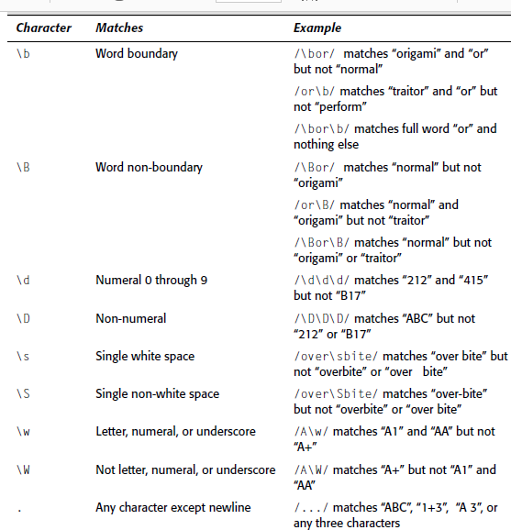
JavaScript Regular Expression Matching Metacharacters
Internet Programming

Slide 63
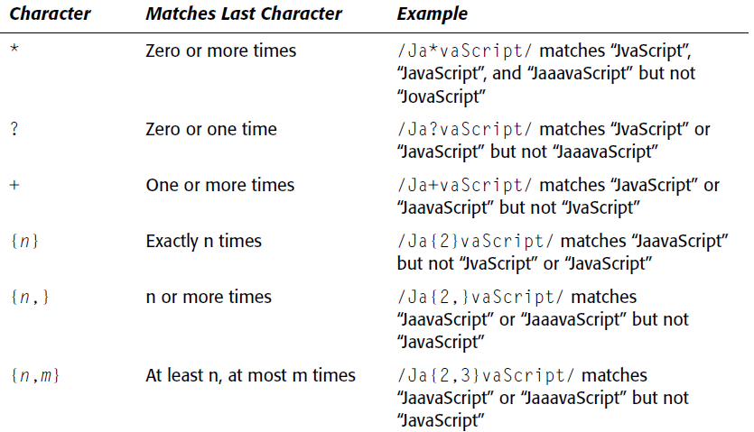
JavaScript Regular Expression Counting
Metacharacters

Slide 64
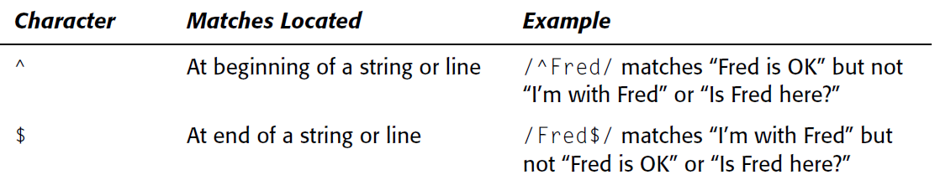
JavaScript Regular Expression Positional
Metacharacters

Slide 65
Example
  var re5digit=/^\d{5}$/
    ^ indicates the beginning of the string. Using a ^ metacharacter requires that the match start at the beginning.
    \d indicates a digit character and the {5} following it means that there must be 5 consecutive digit characters.
    $ indicates the end of the string. Using a $ metacharacter requires that the match end at the end of the string.

Slide 66
Exercise: write pattern for:
A) FirstName, MiddleName, L.
B) (+251)911-01-01-01
C) (the last three characters should be digits)
  E.g. user123
a)
/^[A-z]+, [A-z]+, [A-Z]\.?$/;
b)
/\(\+\d{3}\)\d{3}-\d{2}-\d{2}-\d{2}/;
c)
/\d\d\d$/;

Slide 67
Events
Events are actions that can be detected by JavaScript.
A JavaScript can be executed when an event occurs, like when a user clicks on an HTML element, moves the mouse, etc.
Every element on a web page has certain events which can trigger a JavaScript. For example, we can use the onClick event of a button element to indicate that a function will run when a user clicks on the button.

Slide 68
Cont’d
Examples of events:
    When a user clicks the mouse
    When a web page has loaded
    When an image has been loaded
    When the mouse moves over an element
    When an input field is changed
    When an HTML form is submitted
    When a user strokes a key
<html>
<body>
<h1 onclick="this.innerHTML='Ooops!'">Click on this text!</h1>
</body>
</html>

Slide 69
Cont’d
onLoad and onUnload
The onLoad and onUnload events are triggered when the user enters or leaves the page.
The onLoad event is often used to check the visitor's browser type and browser version, and load the proper version of the web page based on the information.
Both the onLoad and onUnload events are also often used to deal with cookies that should be set when a user enters or leaves a page. For example, you could have a popup asking for the user's name upon his first arrival to your page. The name is then stored in a cookie. Next time the visitor arrives at your page, you could have another popup saying something like: "Welcome John Doe!".

Slide 70
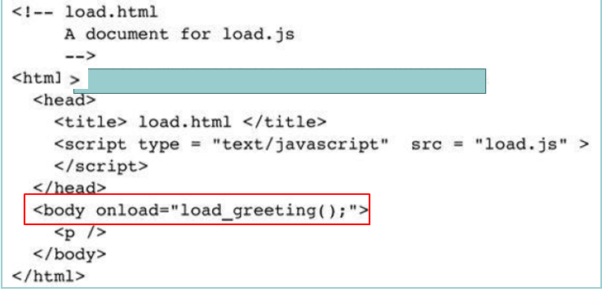
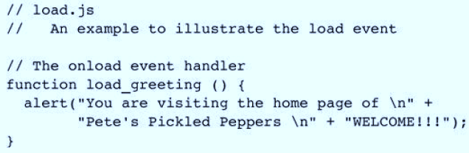
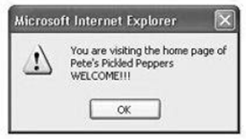
Example

Slide 71
Cont’d
The onchange Event
The onchange event are often used in combination with validation of input fields.
<input type="text" size="30" id="email" onchange="checkEmail()">
onFocus
User just moved into this form element.
onBlur:
A form field lost the focus (User moved to another field)

Slide 72
Example: onBlur
<html>
<head>
<script>
function myFunction(){
var x=document.getElementById("fname");
x.value=x.value.toUpperCase();
}
</script>
</head>
<body>
Enter your name: <input type="text" id="fname” onBlur="myFunction()">
<p>When you leave the input field, a function is triggered which transforms the input text to upper case.</p>
</body>
</html>

Slide 73
Cont’d
onSubmit
The onSubmit event is used to validate ALL form fields before submitting it
<form method="post" action="xxx.htm" onsubmit="return checkForm()">
onmouseover : A mouse moved off of this element
onmouseout : The mouse moved over this element.

Slide 74
Example
<html>
<body>
<div onmouseover="mOver(this)" onmouseout="mOut(this)"
style="background-color:#D94A38; width:120px; height:20px;
padding:40px;">Mouse Over Me
</div>
<script>
function mOver(obj){
obj.innerHTML="Thank You"
}
function mOut(obj){
obj.innerHTML="Mouse Over Me"
}
</script>
</body>
</html>

Slide 75
JavaScript Form Validation
JavaScript provides a way to validate form's data on the client's computer before sending it to the web server. Form validation generally performs two functions.
Basic Validation - First of all, the form must be checked to make sure all the mandatory fields are filled in. It would require just a loop through each field in the form and check for data.
Data Format Validation - Secondly, the data that is entered must be checked for correct form and value. Your code must include appropriate logic to test correctness of data.

Slide 76
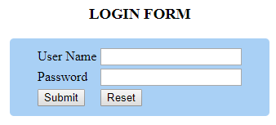
Login Validation: Example
function validate(){
var username = document.loginform.user_id;
var password = document.loginform.user_pass;
if (username.value == "" || password.value=="")
{
alert("User Id/password should not be empty");
return false;
}
return true;
}

Slide 77
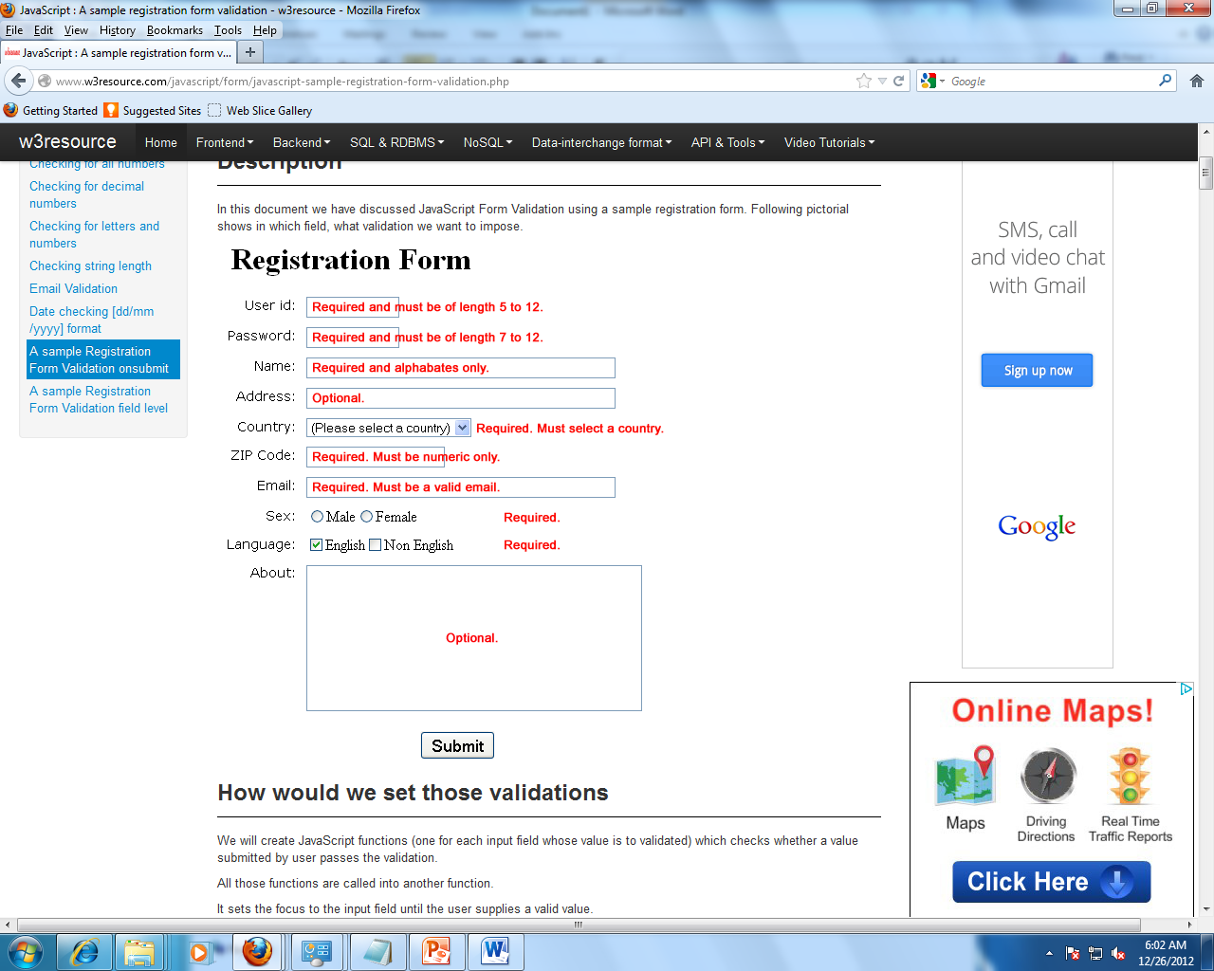
Form validation Example
Internet Programming

Slide 78
Email id validation explanation:
/^\w+([\.-]?\w+)*@\w+([\.-]?\w+)*(\.\w{2,3})+$/
Character | Description
Character | Description
/ .. / | All regular expressions start and end with forward slashes.
^ | Matches the beginning of the string or line.
\w+ | Matches one or more word characters
[\.-] ? | \ Indicates that the next character is special and not to be interpreted literally. .- matches 0 or 1 occurrence of . or -.
\w+ | Matches 1 or more word characters
([.-]?\w+)* | matches 0 or more occurrences of [.-]?\w+.
@ | It matches only @ character.
\w+([.-]?\w+)* | It matches the domain name with the same pattern of user name described above
\.\w{2,3} | It matches a . followed by two or three word characters, e.g., .edu, .org, .com, .uk, .us, .co etc.
+ | The + sign specifies that the above sub-expression shall occur one or more times, e.g., .com, .co.us, .edu.uk etc.
$ | Matches the end of the string or line.
Internet Programming

